Slide 1
Sprint 04
TadoSoft
Team JJJ
27, Jul, 2011

Slide 2
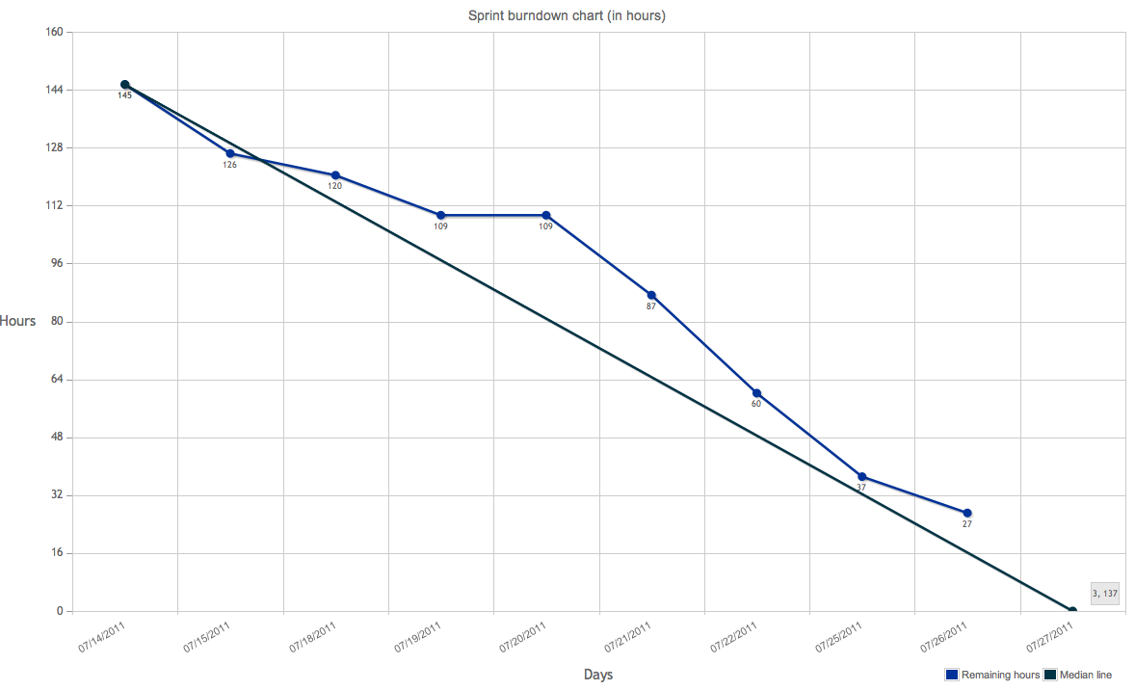
Burndown chart

Slide 3
DoD
Code
code style: Follow Xcode/Eclipse default style
complexity: <= 15 for each function (with hfcca or cyvis tool)
duplexity: <= 50 for each function (with CPD tool)
no fault
no warning
use DLog() instead of NSLog() in Obj-C
frozen version for every sprint with a GIT tag
Test
no leaks for Obj-C with XCode Instrument
Capacity&Performance test for server
unit test
Manually functional test
Document
class doc generated by Doxygen for every class, function, variable, constant with Javadoc style
design doc in word format, stored in GIT
Functional test cases(Precondition, Expect result, steps, Actual result, tester, date)

Slide 4
Committed Items
162 Create Post
140 Profile
147 More Page
154 Extras Page
123 Settings
145 Basic Krowd
148 Event Screen
157 Location Maps
158 Leave Krowd
185 Basic Welcome Screen
187 Disable Network

Slide 5
Code Complexity (objC on iPhone)
Meet DoD.

Slide 6
Document
http://192.168.1.113/mediawiki/index.php/AcceptanceTestCase

Slide 7
Issues
http://192.168.1.113/mantis/view_all_bug_page.php

Slide 8
Q&A

Slide 9
Retrospective

